Slide 1
Unlocking the Gaze: A Comprehensive Analysis of Eye-Tracking Data in ECG Interpretation
Surya Tejaswi Yerramsetty

Slide 2
Understanding Data
This dataset contains eye tracking data collected from medical practitioners and students with varying levels of expertise in order to better understand their electrocardiogram interpretation behavior.
Data was collected using a Tobii Pro X2-60 eye tracker and iMotions version 8.1 software to track eye movements at a frequency of 60 Hz (±1 Hz). A collection of 630 distinct ECG interpretations was generated.
The data consists of quantitative eye tracking measurements for different eye gaze features for 63 participants. These participants belong to six expertise categories, namely: medical students, nurses, technicians, residents, fellows and consultants with 15372 observations and 29 columns.

Slide 3
Introduction:
As we all know, the electrocardiogram (ECG) is one of the most commonly used medical tests in modern medicine, with over 300 million ECGs performed annually in the United States alone.
The goal of this eye-tracking study is use to measure and analyze variations in visual behavior used when interpreting various types of ECGs to identify different levels of expertise such as medical students, nurses, technicians, fellows, and consultants.

Slide 4
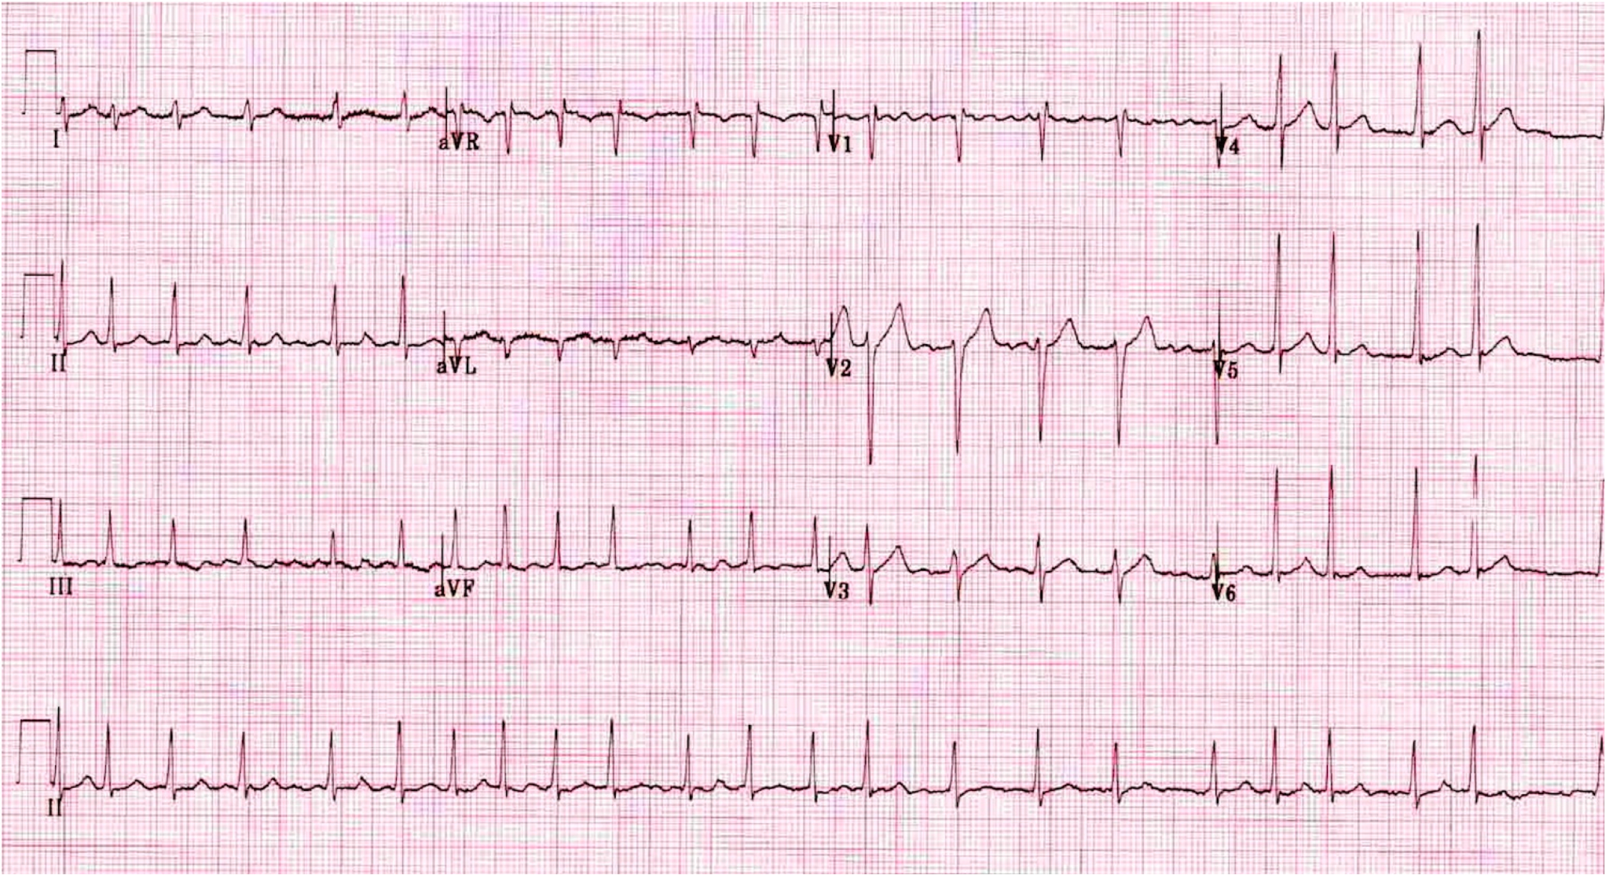
Understanding Data(Contd.)
Notes:
Features are defined across AOI. AOI defines the area by which other eye tracking metrics are calculated. AOIs are eye-tracking tools for selecting regions of a displayed stimulus. In our case, the stimulus is the displayed 12-leads ECG.
Data is in the format of frames. Each frame is a line in the dataset file where eye tracking metrics, including fixations and gaze data.
The total number of lines in the grid-based AOI is 15373 lines.

Slide 5
Data Cleaning:
Dropping unnecessary columns:
The 'Unnamed: 0' ,’Type’ and 'Study_name' columns were dropped as they were not relevant to the analysis.
Imputing missing values:
Numerical columns were imputed with the mean of their respective columns.
Object columns were imputed with the most frequent value (mode).
Encoding categorical features:
Label encoders were used to transform categorical features into numerical values for easier processing by machine learning algorithms.
Scaling continuous features:
Standard scaling was applied to continuous features to ensure they have the same scale and prevent bias during analysis.
Handling zero age values:
Zero values in the 'Age' column were replaced with the median age of participants with non-zero age values.

Slide 6
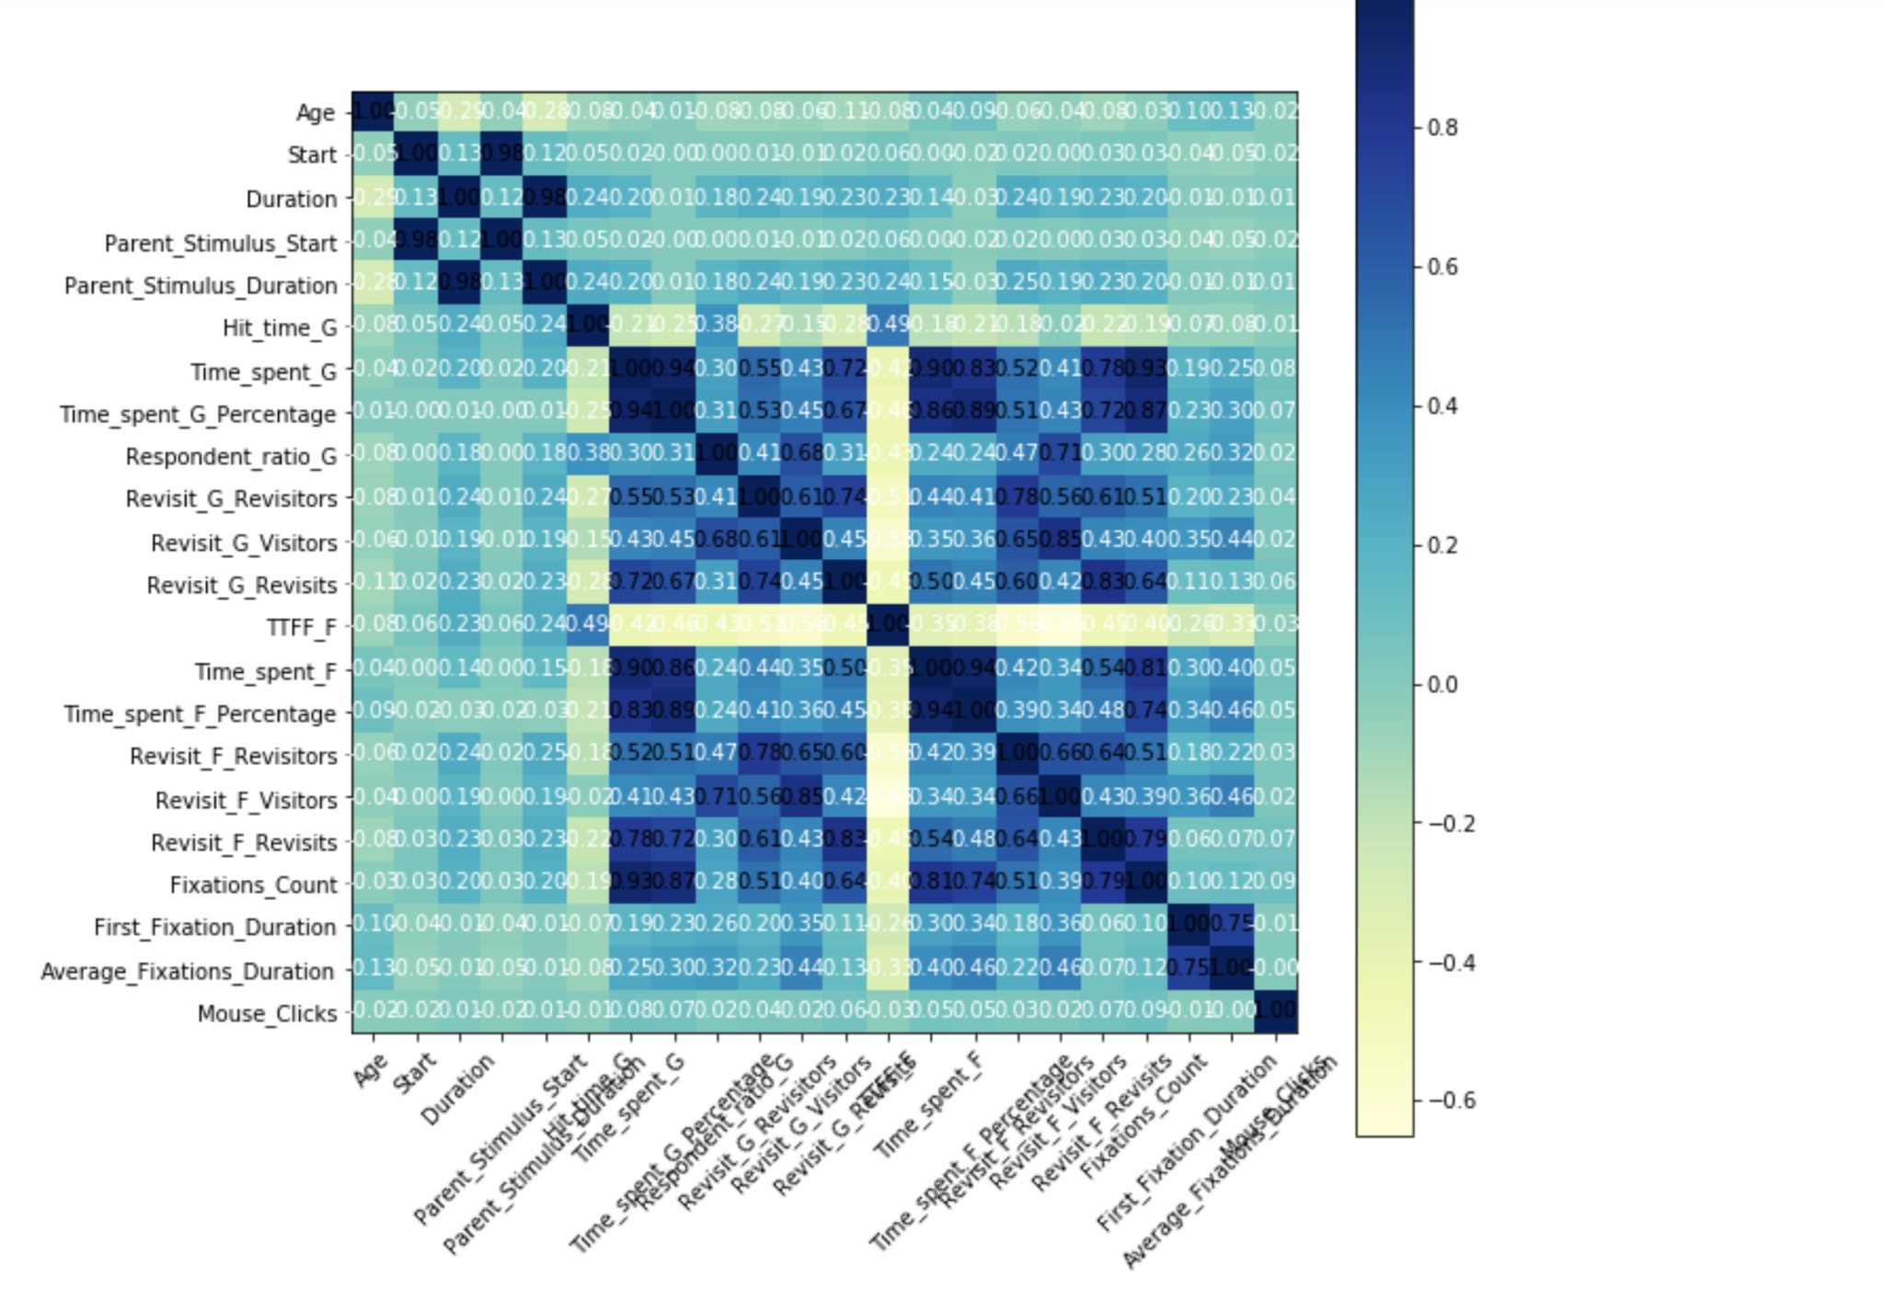
Correlation Matrix:

Slide 7
Features: | Nature of variable | Meaning
Group | Categorical | The expertise category to which the participant belongs to
Fixations_Count | Continuous | The total count of the number of fixations across the AOI in question
First_Fixation_Duration | Continuous | The duration in milliseconds for the first fixation of the participant at the AOI in question.
Average_Fixations_Duration | Continuous | The average fixations duration in milliseconds for the total fixations of the participant at the AOI in question.
Time_spent_F_Percentage | Continuous | The percentage in terms of time that the participant spent fixating at the AOI in question.
Mouse_Clicks | Continuous | The number of mouse clicks by the participant in the AOI in question
Revisit_F_Revisits | Categorical | The number of revisits that the participant refixated the AOI in question.
Revisit_F_Visitors | Categorical | Whether the participant re-fixated the AOI in question
Revisit_F_Revisitors | Categorical | Whether there exists participants that re-fixated (revisitors) the AOI in question
Duration | Continuous | The duration for which the ECG remained displayed to the participant

Slide 8
Research Questions:
Objective 1: User expertise - performed a multinomial classification to predict the expertise of various participants in the study
Predicting User Expertise: Utilizing multinomial classification, we aim to accurately identify the expertise level of participants in the study.
Objective 2: What individual characteristics predict whether a participant will revisit a grid-based AOI?
Unveiling Revisiting Factors: We explore what individual characteristics predict whether a participant will revisit a specific grid-based AOI.
Objective 3: Use a regression model to predict the time spent on each AOI (Time_spent_G) based on the practitioner's group (Group) and other features. This will quantify the influence of practitioner role on attention allocation to specific AOIs.
Quantifying Practitioner Role Influence: Employing a regression model, we strive to quantify the influence of practitioner role on the time spent on each AOI (Time_spent_G) based on group affiliation and other relevant features.

Slide 9
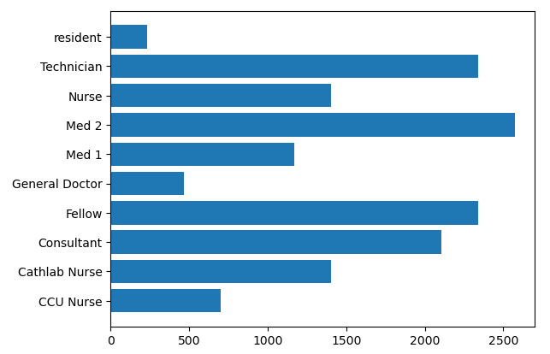
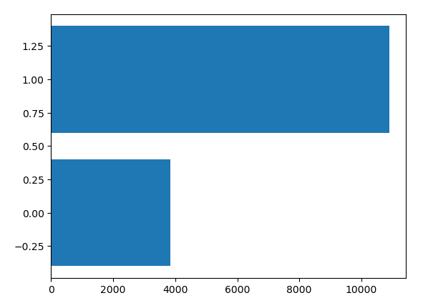
Distribution Of Target Classes

Slide 10
USER EXPERTISE

Slide 11
SMOTE
SMOTE stands for "Synthetic Minority Over-sampling Technique." It is an advanced technique used to address class imbalance in machine learning datasets. Instead of simply duplicating existing minority class samples, SMOTE generates synthetic samples for the minority class by interpolating between existing samples. It aims to balance the class distribution by creating synthetic examples that are similar to the existing minority class samples but not identical.
Reducing Overfitting
Improved Generalization
Handling Class Imbalance

Slide 12
CLASS | Before Sampling | After sampling - 1 | After sampling -2
CCU Nurse | 732 | 732 | 1500
Cath Lab Nurse | 1464 | 1464 | 1464
Consultant | 2196 | 2000 | 2196
Fellow | 2440 | 2000 | 2440
General Doctor | 488 | 2000 | 1500
Med 1 | 1220 | 2000 | 1220
Med2 | 2684 | 2000 | 2684
Nurse | 1464 | 1464 | 1464
Technician | 2440 | 2000 | 2440
Resident | 244 | 2000 | 600

Slide 13
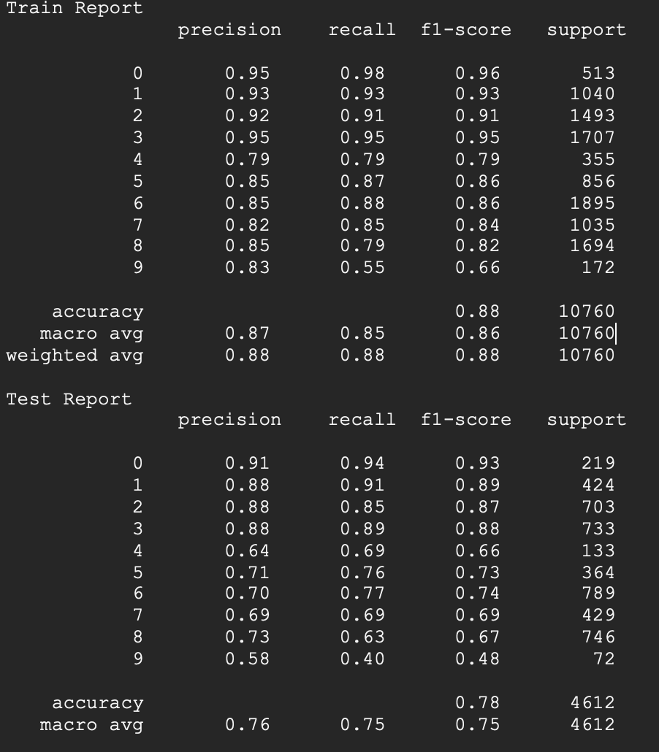
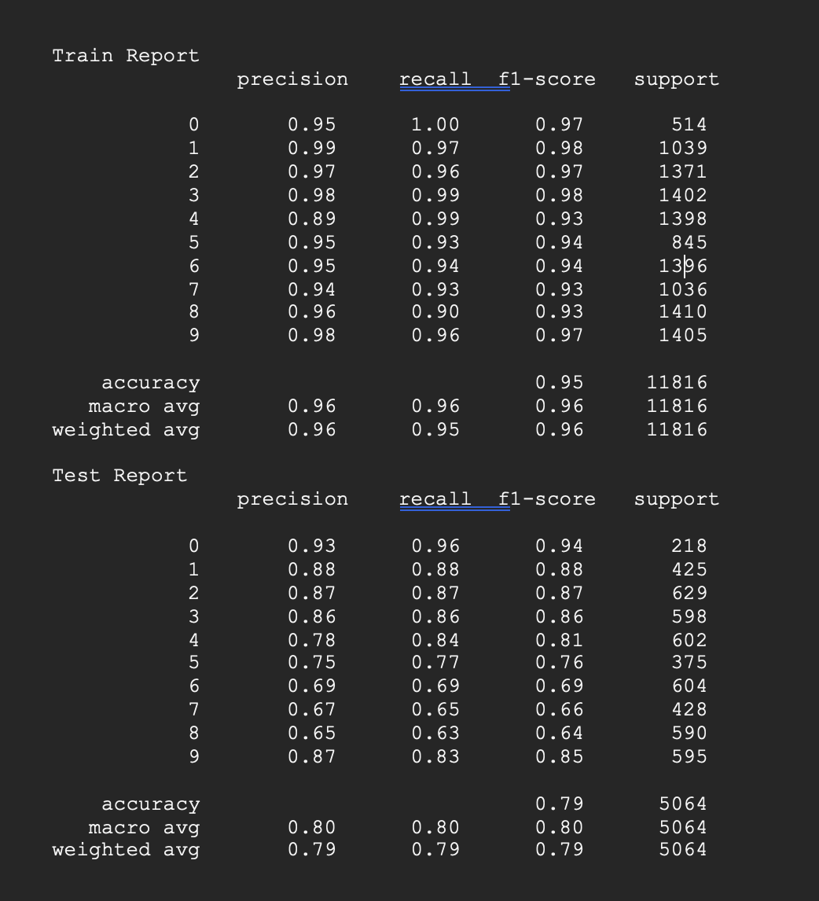
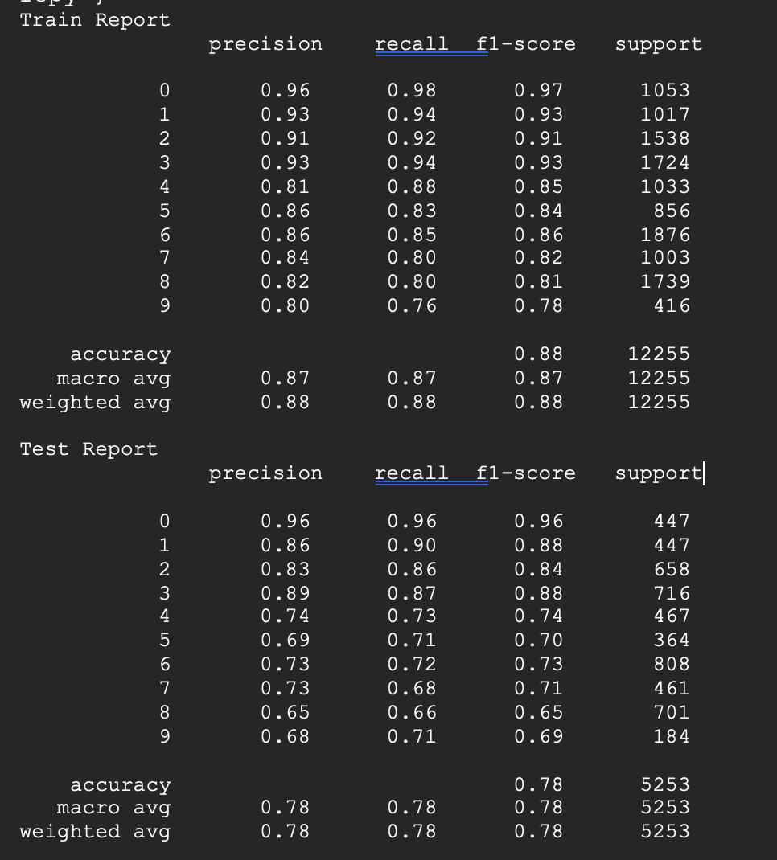
DECISION TREE
Before Resampling
After Resampling(OverSampling undersampling)
After Resampling(OverSampling)

Slide 14
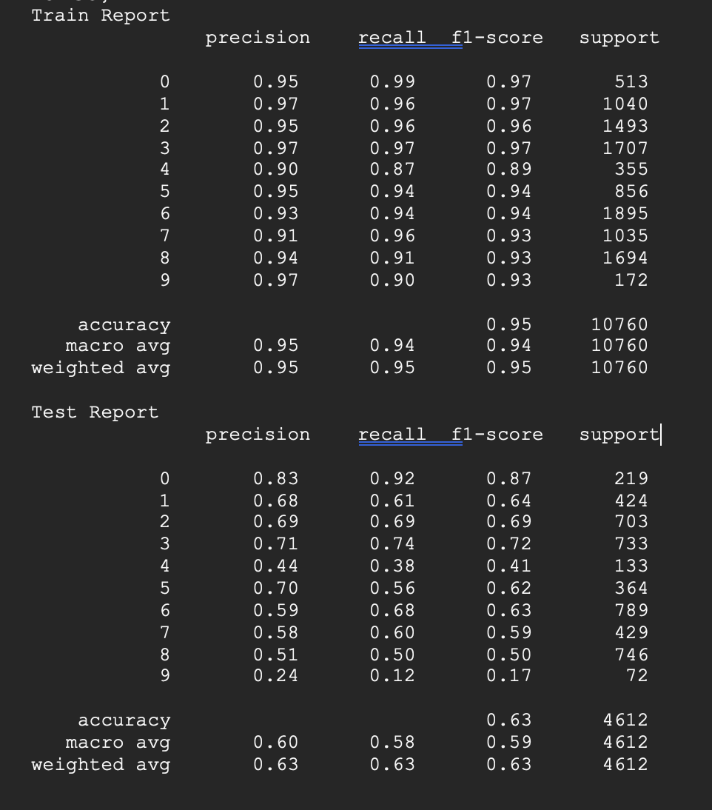
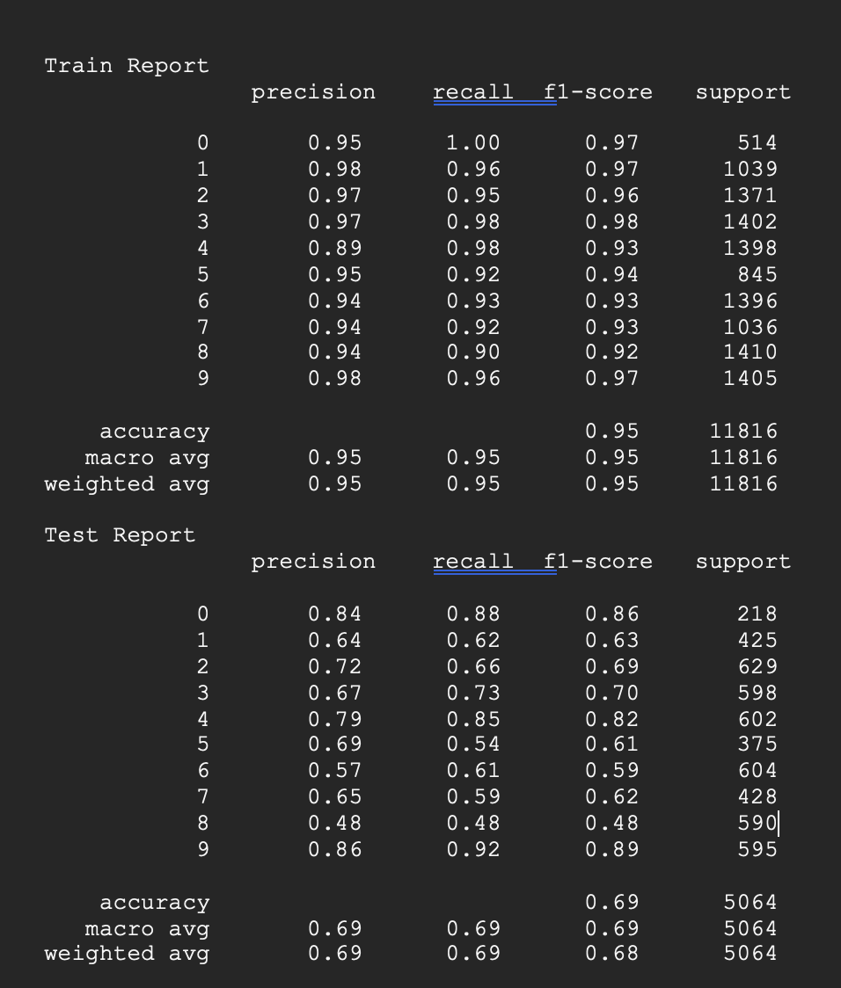
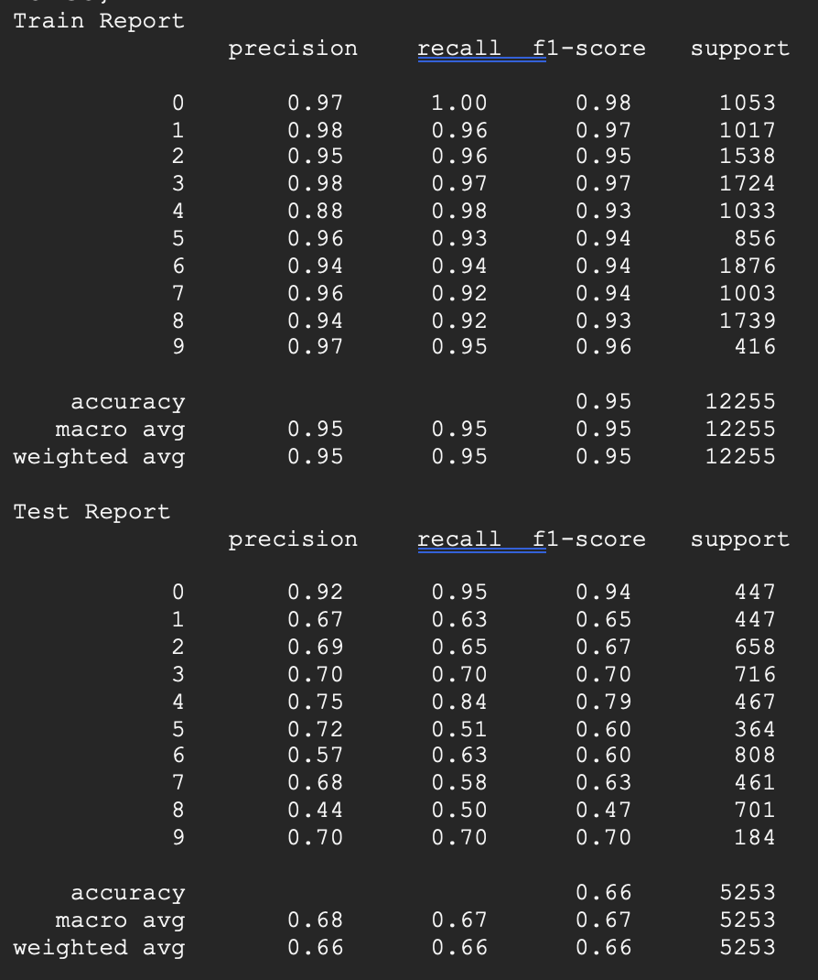
RANDOM FOREST
Before Resampling
After Resampling(OverSampling undersampling)
After Resampling(OverSampling)
Notes:
If there is a significant class imbalance within specific features or variables, Random Forest might not handle them well, even after resampling.

Slide 15
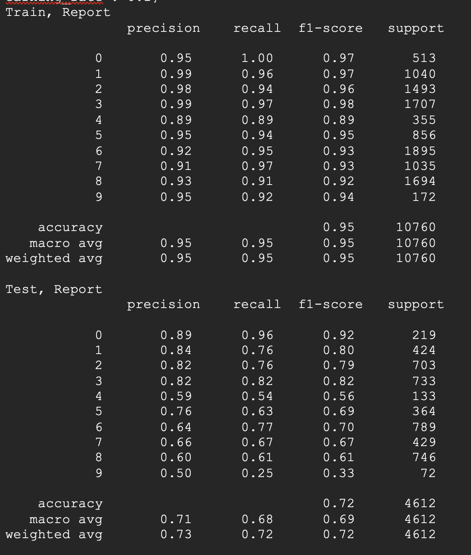
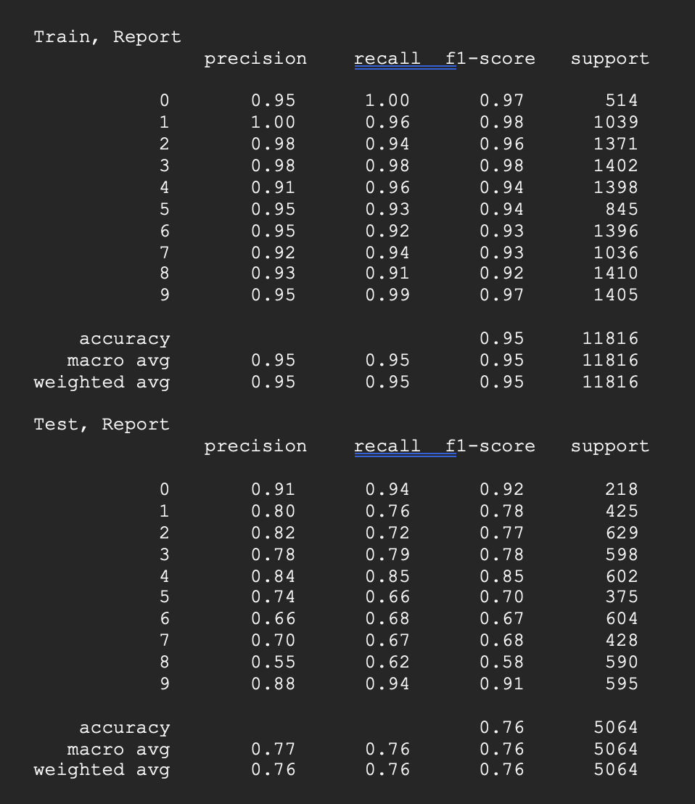
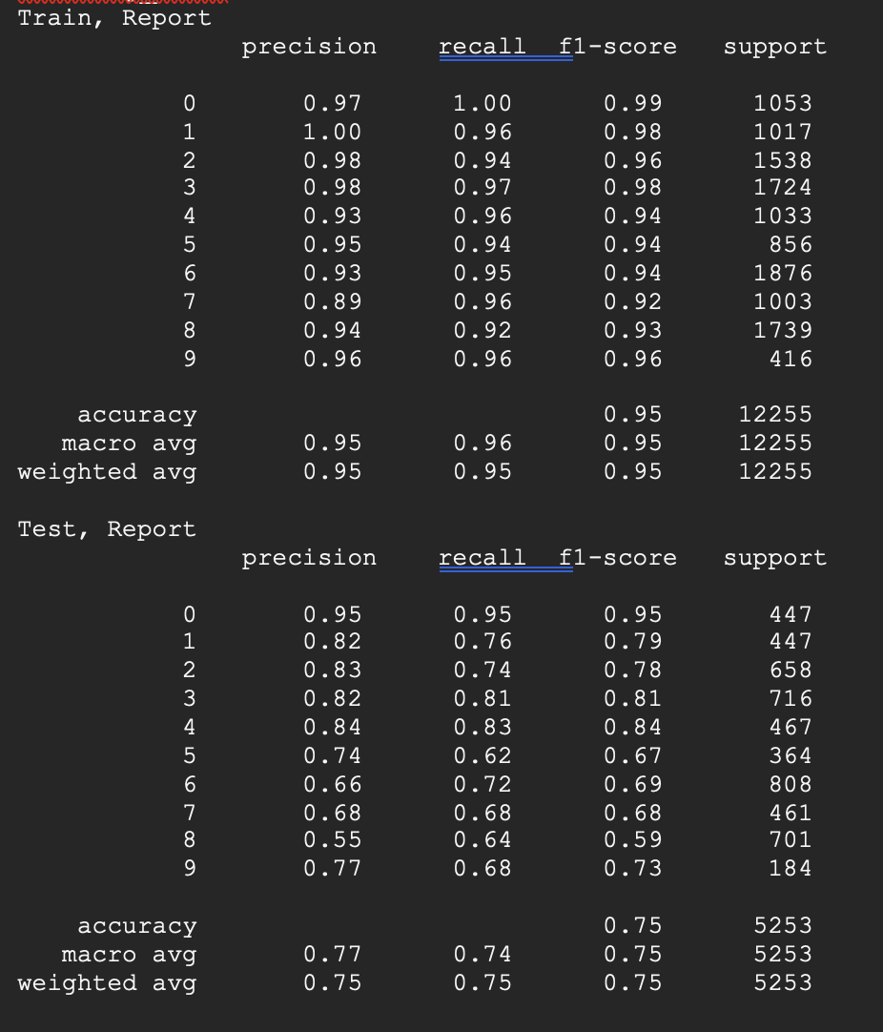
GRADIENT BOOSTING
Before Resampling
After Resampling(OverSampling undersampling)
After Resampling(OverSampling)
Notes:
GBM is a powerful ensemble learning method that can perform well for classification tasks, but its performance can be influenced by various factors, including the preprocessing techniques used and the dataset's characteristics. In your cases, it performed well, especially when you balanced the dataset using resampling techniques (Case 1). However, the performance dropped slightly in Case 2, where you oversampled specific classes without undersampling.There ar efew classes where there is high variance, so we didn’t consider the gradient boosting

Slide 16
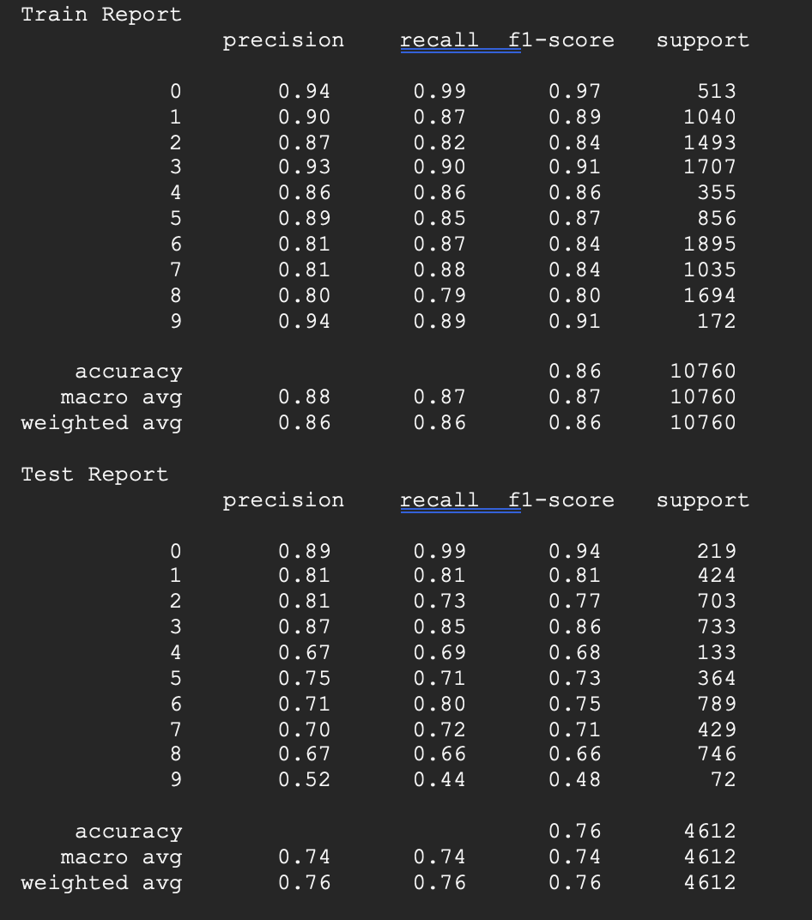
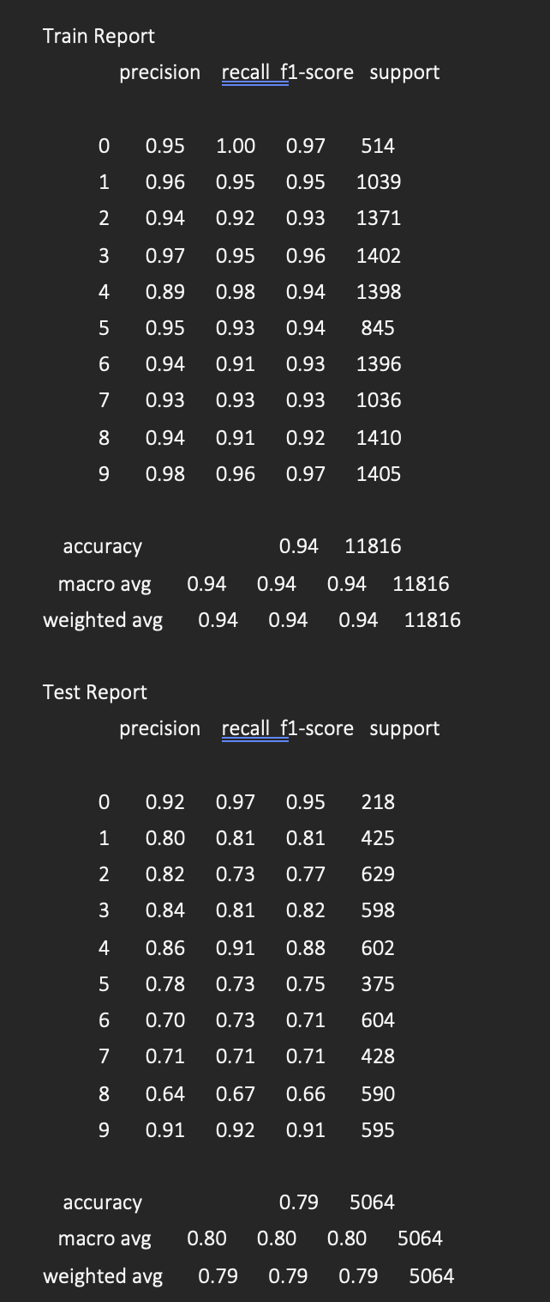
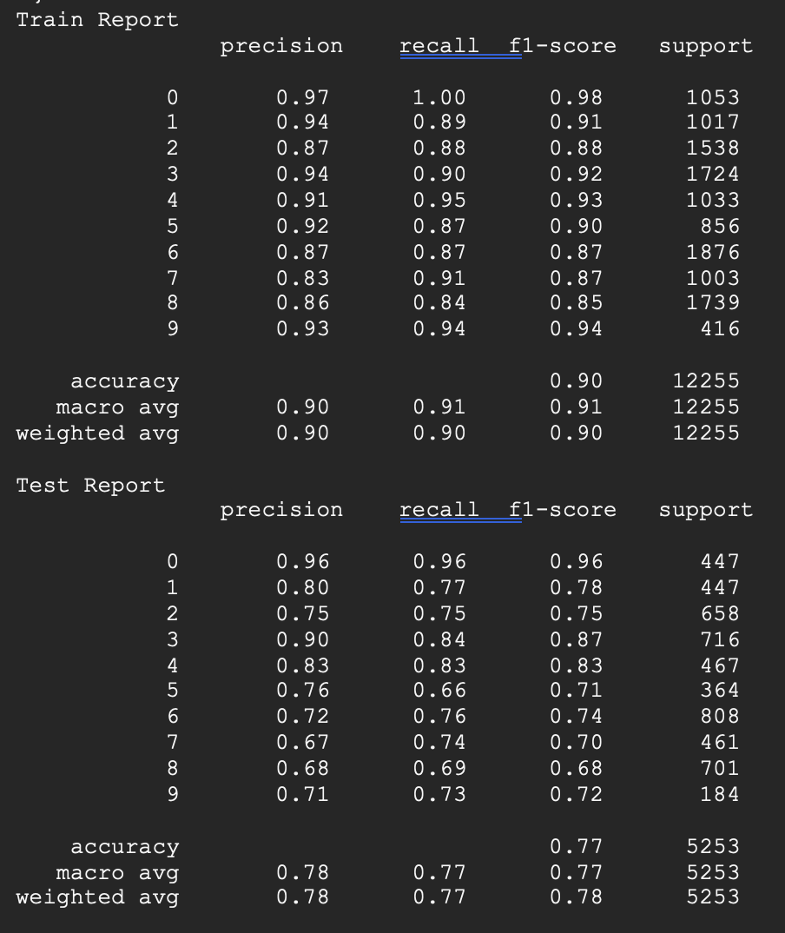
LIGHT GRADIENT BOOSTING
Before Resampling
After Resampling(OverSampling undersampling)
After Resampling(OverSampling)

Slide 17
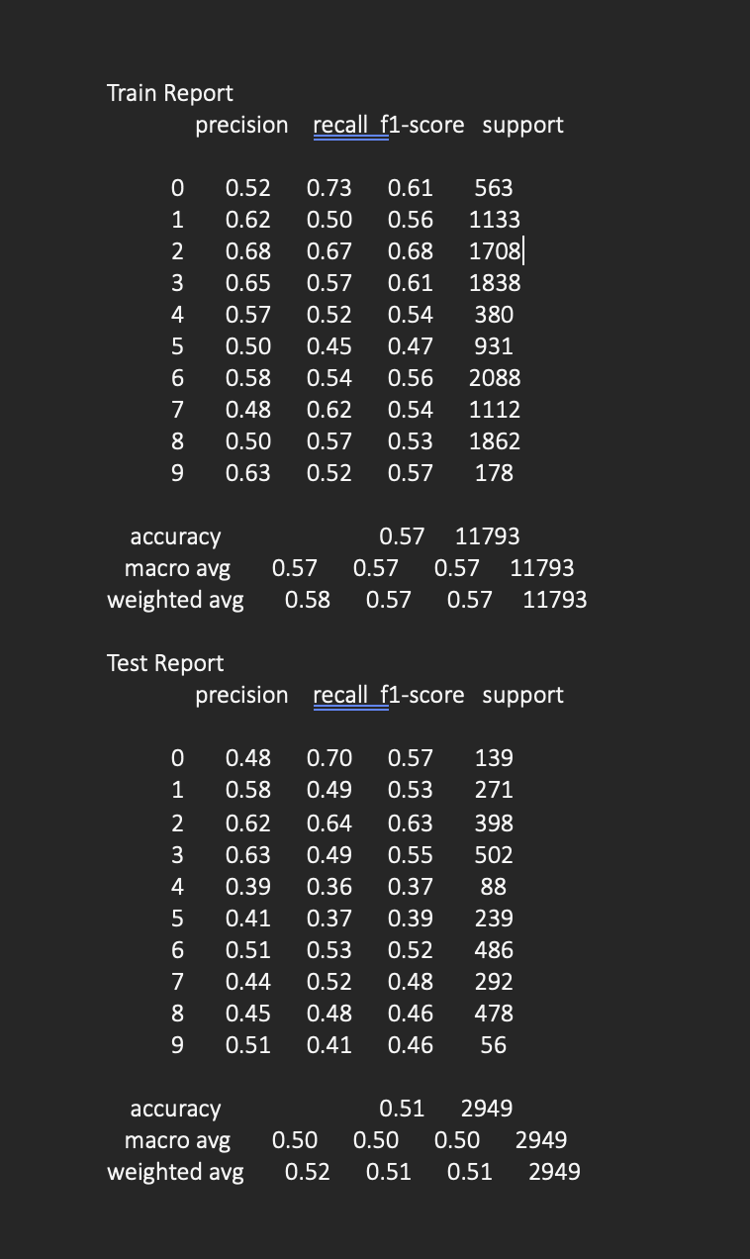
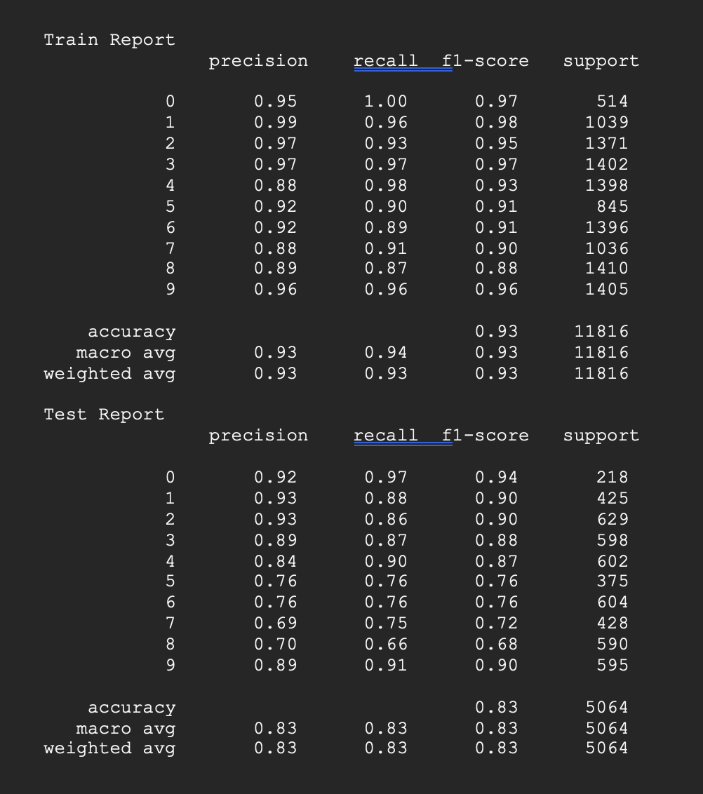
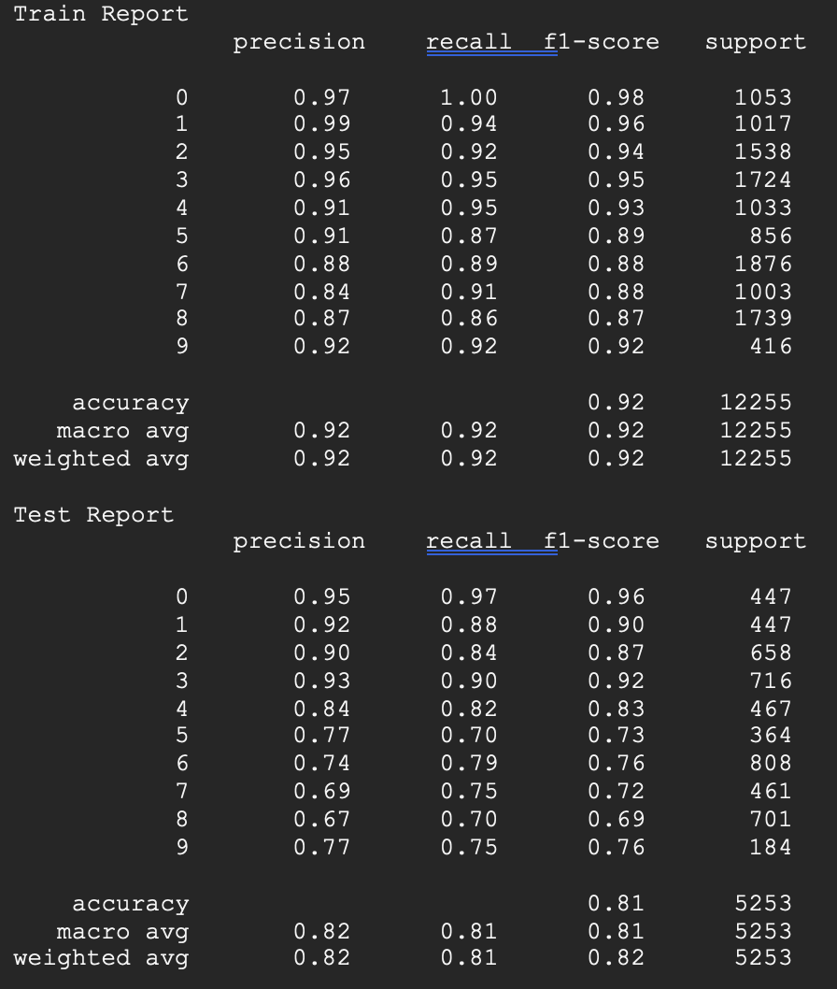
XG BOOSTING
Before Resampling
After Resampling(OverSampling undersampling)
After Resampling(OverSampling)
Notes:
XGBoost is performing well after resampling because these techniques help to address class imbalance, which is likely present in the dataset. Class imbalance can cause models to be biased towards the majority class, performing poorly on the minority class. By resampling, the dataset becomes more balanced, allowing the algorithm to learn more about the underrepresented classes, which generally leads to better overall performance, as evidenced by the increased metrics across the board.

Slide 18
USER EXPERTISE
After comparing the performance of Case 1 (Oversampling and Undersampling) and Case 2 (Oversampling Only) after resampling, it appears that Case 2 is generally better.
Case 2 tends to achieve better F1-scores, which suggests that it is a more effective approach for addressing the class imbalance issue in this particular dataset.
Comparing the F1-Scores, we can see that the XGBoost algorithm performed the best among the tested algorithms.

Slide 19
Objective 2:
What individual characteristics predict whether a participant will revisit a AOI?
Target: Revisit_G_Visitors
0: If the value of Revisit-G is 0, it means that the participant did not revisit the grid-based AOI after their initial visit. [Count - 3848 ]
1: If the value of Revisit-G is 1, it means that the participant revisited the grid-based AOI at least once after their initial visit. [Count - 11524]
This is an unbalanced binary classification problem
Features : Group, Time_spent_F ,Time_spent_G, Fixations_Count
Performed a chi-square test between the Group and Revisit_G_Visitors
Chi-square value: 217.97
P-value: 2.5126385295723863e-4
Variable Selection : Used Random forest Feature importance and selected the continuous features.
Notes:
We have performed these tasks in order to understand more about our data and associations in between them.
The revisit is our target categorical variable

Slide 20
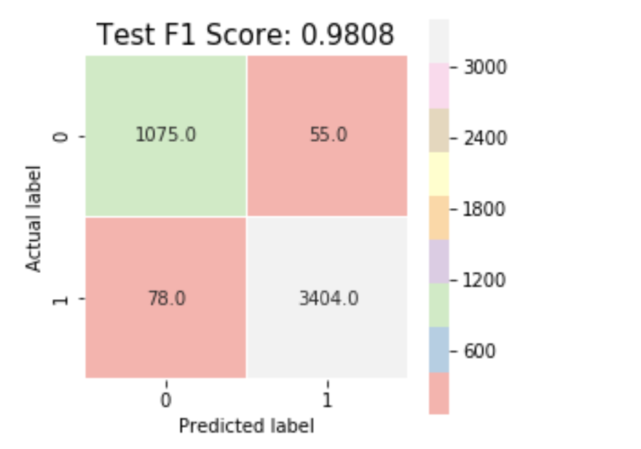
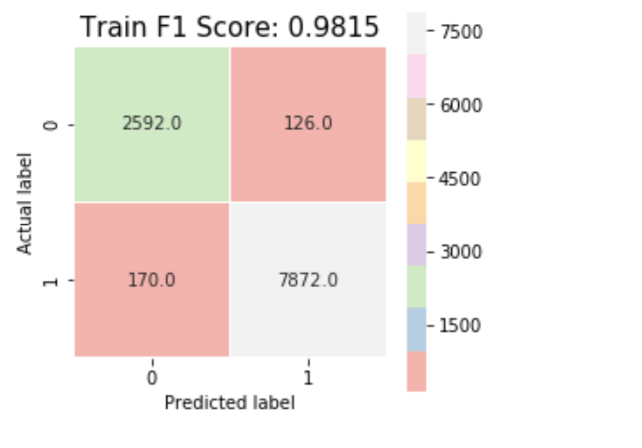
Machine Learning models:
Logistic regression and Support Vector Machine ( Kernel = Rbf )
To handle false positives and false negatives is equally important for this specific problem.
So, considering F1 score as a deciding factor for model performance.
Support Vector Machine
Notes:
We have used Logistic regression and SVM and both have performed almost similar and well, as this is unbalanced we are clearly not concerned about the accuracy.
We have studied and came to a conclusion that Precision and Recall are equally important

Slide 21
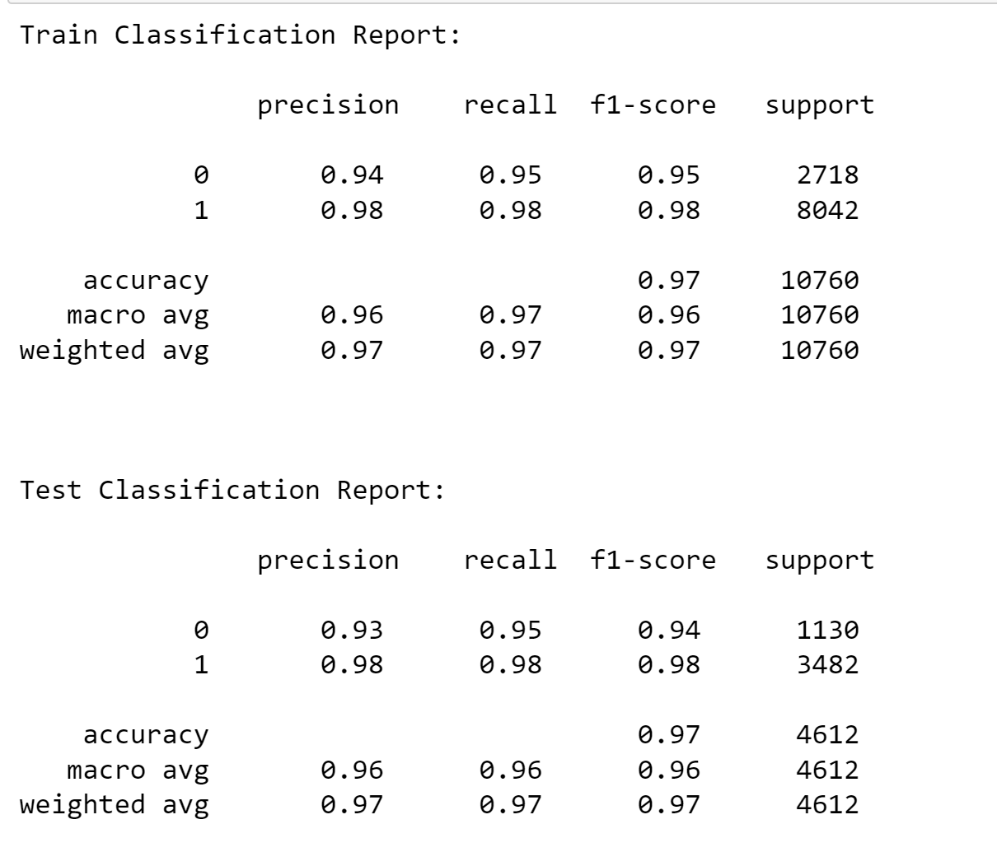
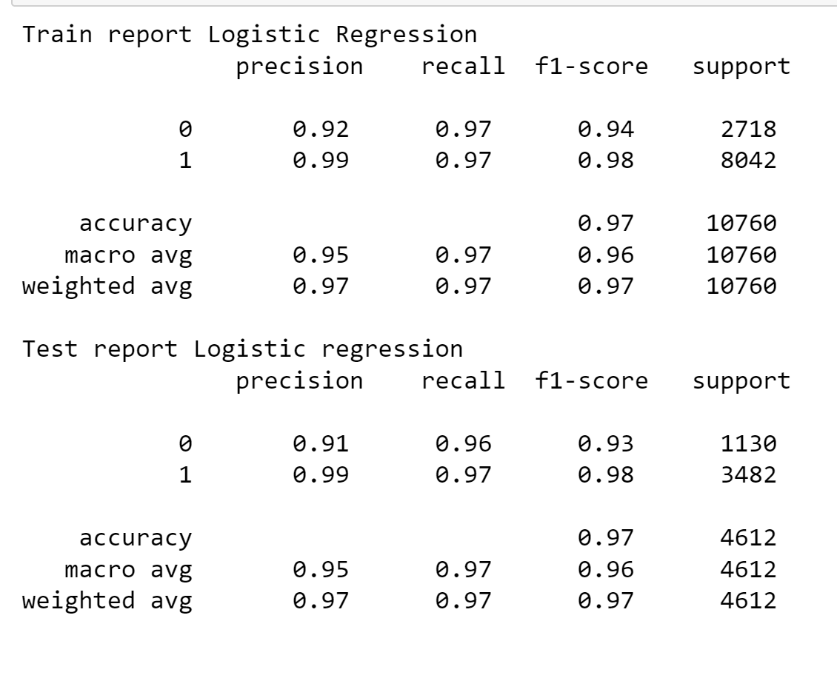
Impression : Both have performed well for both minority and majority classes.
Support Vector Machine
Logistic regression

Slide 22
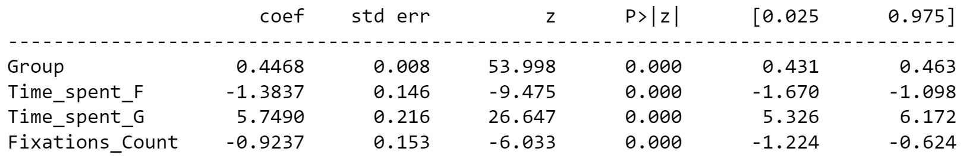
What individual characteristics predict whether a participant will revisit a AOI?
Interpretations:
The longer participants spend gazing at a specific AOI (Area of Interest), the more likely they are to revisit it.
A higher number of fixations on an AOI decreases the probability of revisiting.
Similar to fixations, a longer total fixation time on an AOI decreases the probability of revisiting.
Notes:
This indicates that prolonged attention and engagement with the AOI increase the likelihood of revisiting.
This might suggest that participants who revisit an AOI do so with fewer but longer fixations, focusing more efficiently on relevant information.
This further supports the notion that revisitors engage with the AOI more efficiently, requiring less total fixation time.
This suggests that expertise plays a crucial role in encouraging revisiting behavior.

Slide 23
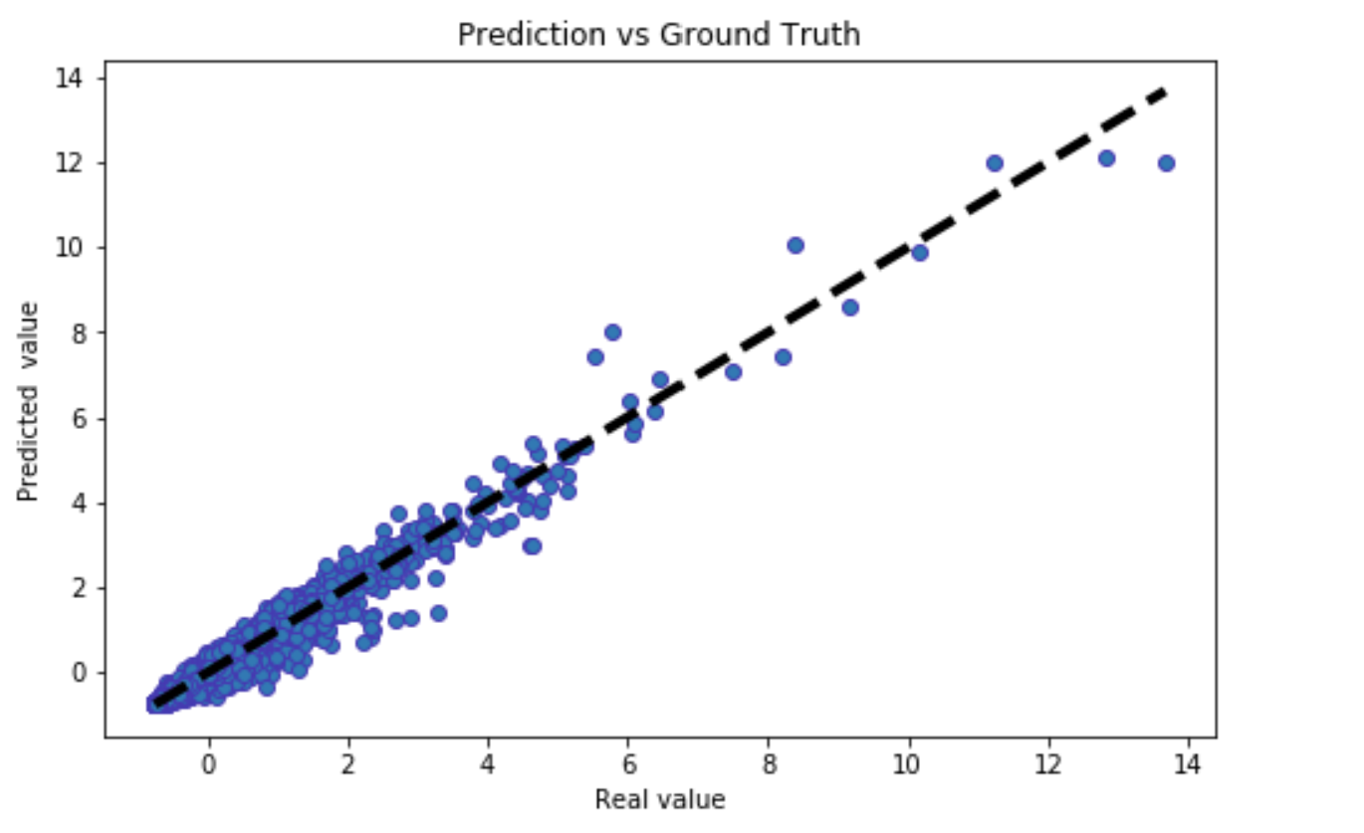
Objective 3: Use a regression model to predict the time spent on each AOI (Time_spent_G) based on the practitioner's group (Group) and other features.
Features: Selected based on the correlation values
Time_spent_F, Revisit_F_Revisitors, Revisit_G_Visitors, Group
Target: Time_spent_G : Quantifies the amount of time that respondents have spent gazing at a particular AOI
Performed Linear regression for this task
Linear Regression | R2 scores
Test: | 0.952141
Train: | 0.969411
Notes:
In this we want too predict the time spent gazing.
This approach can further be used in applications where gaze patterns are need to analysed not only respective to ECG.

Slide 24
References
Dataset: https://physionet.org/content/eye-tracking-ecg/1.0.0/#files-panel
Sqalli, M. T., Al-Thani, D., El‐Shazly, M., Al-Hijji, M., Alahmadi, A., & Houssaini, Y. S. (2022). Understanding Cardiology Practitioners’ Interpretations of Electrocardiograms: An Eye-Tracking Study. JMIR Human Factors, 9(1), e34058. https://doi.org/10.2196/34058

Slide 25
THANK YOU

